Slide 1
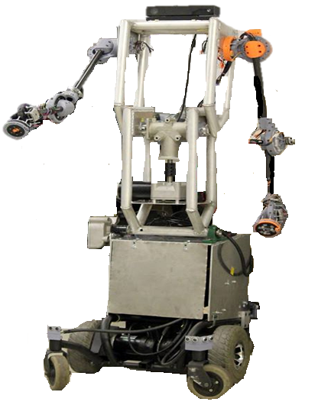
DEVELOPMENT AND ANALYSIS OF ROBOTIC ARMS FOR HUMANOID MELO
He Shen, Salvador Rojas, Eduardo Molina, Francisco Moxo Galicia, Ni Li
Department of Mechanical Engineering
California State University, Los Angeles
5151 State University Dr, Los Angeles, CA 90032
November 13, 2018, ASME IMECE, Pittsburgh, PA

Slide 2

Table of Contents
Background
Motivation
Design Process
Development
Experimental Testing
Conclusion

Slide 3
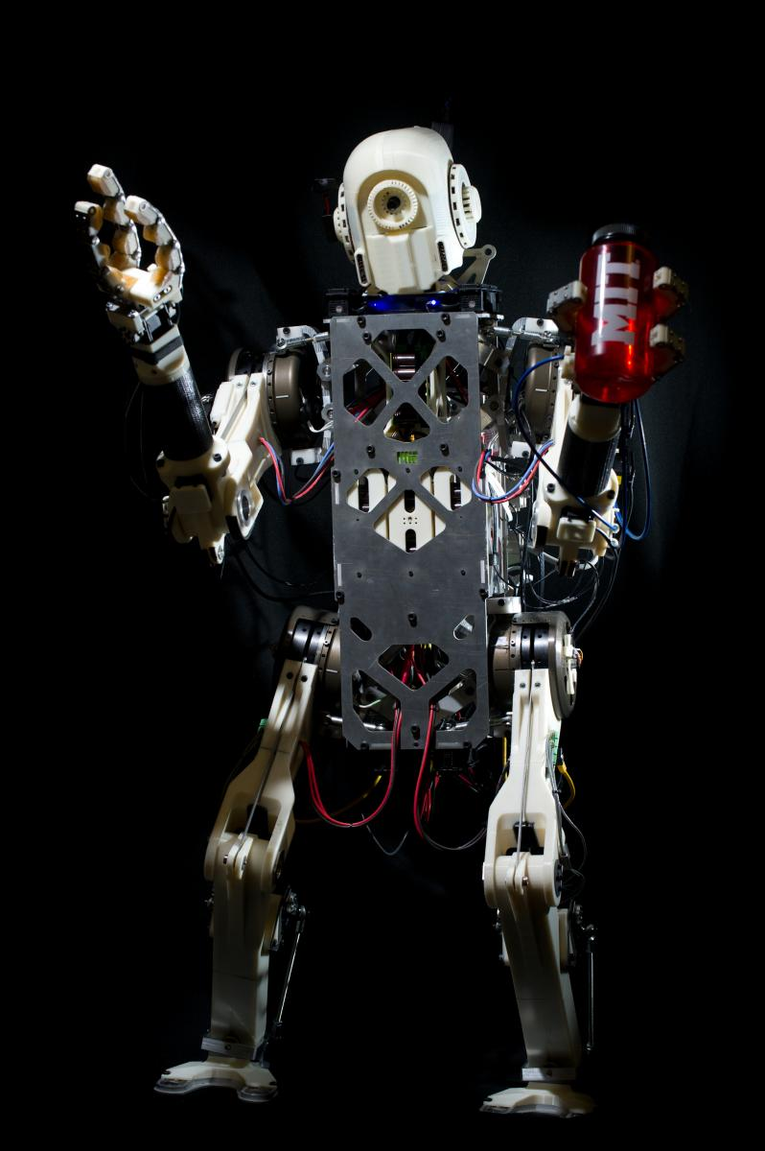
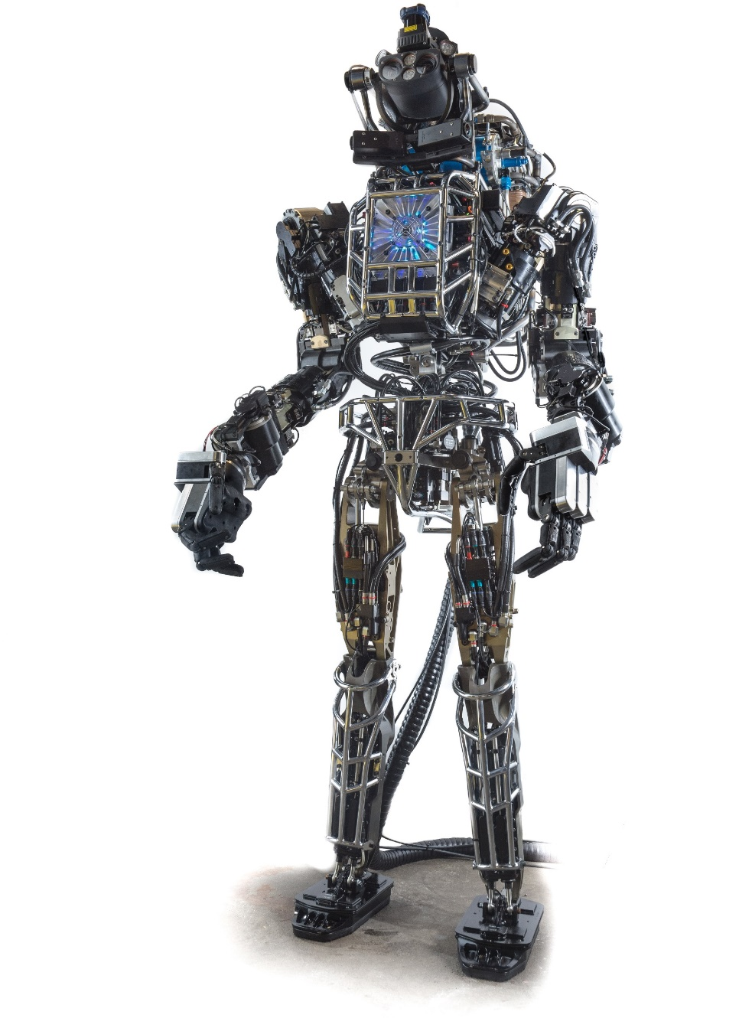
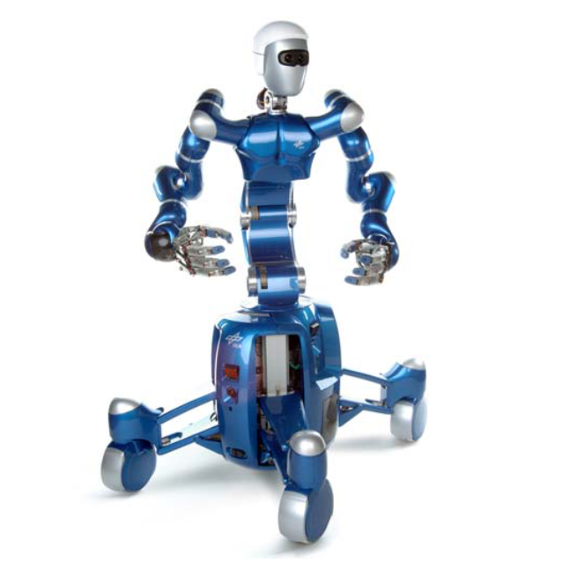
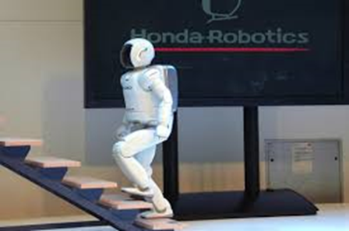
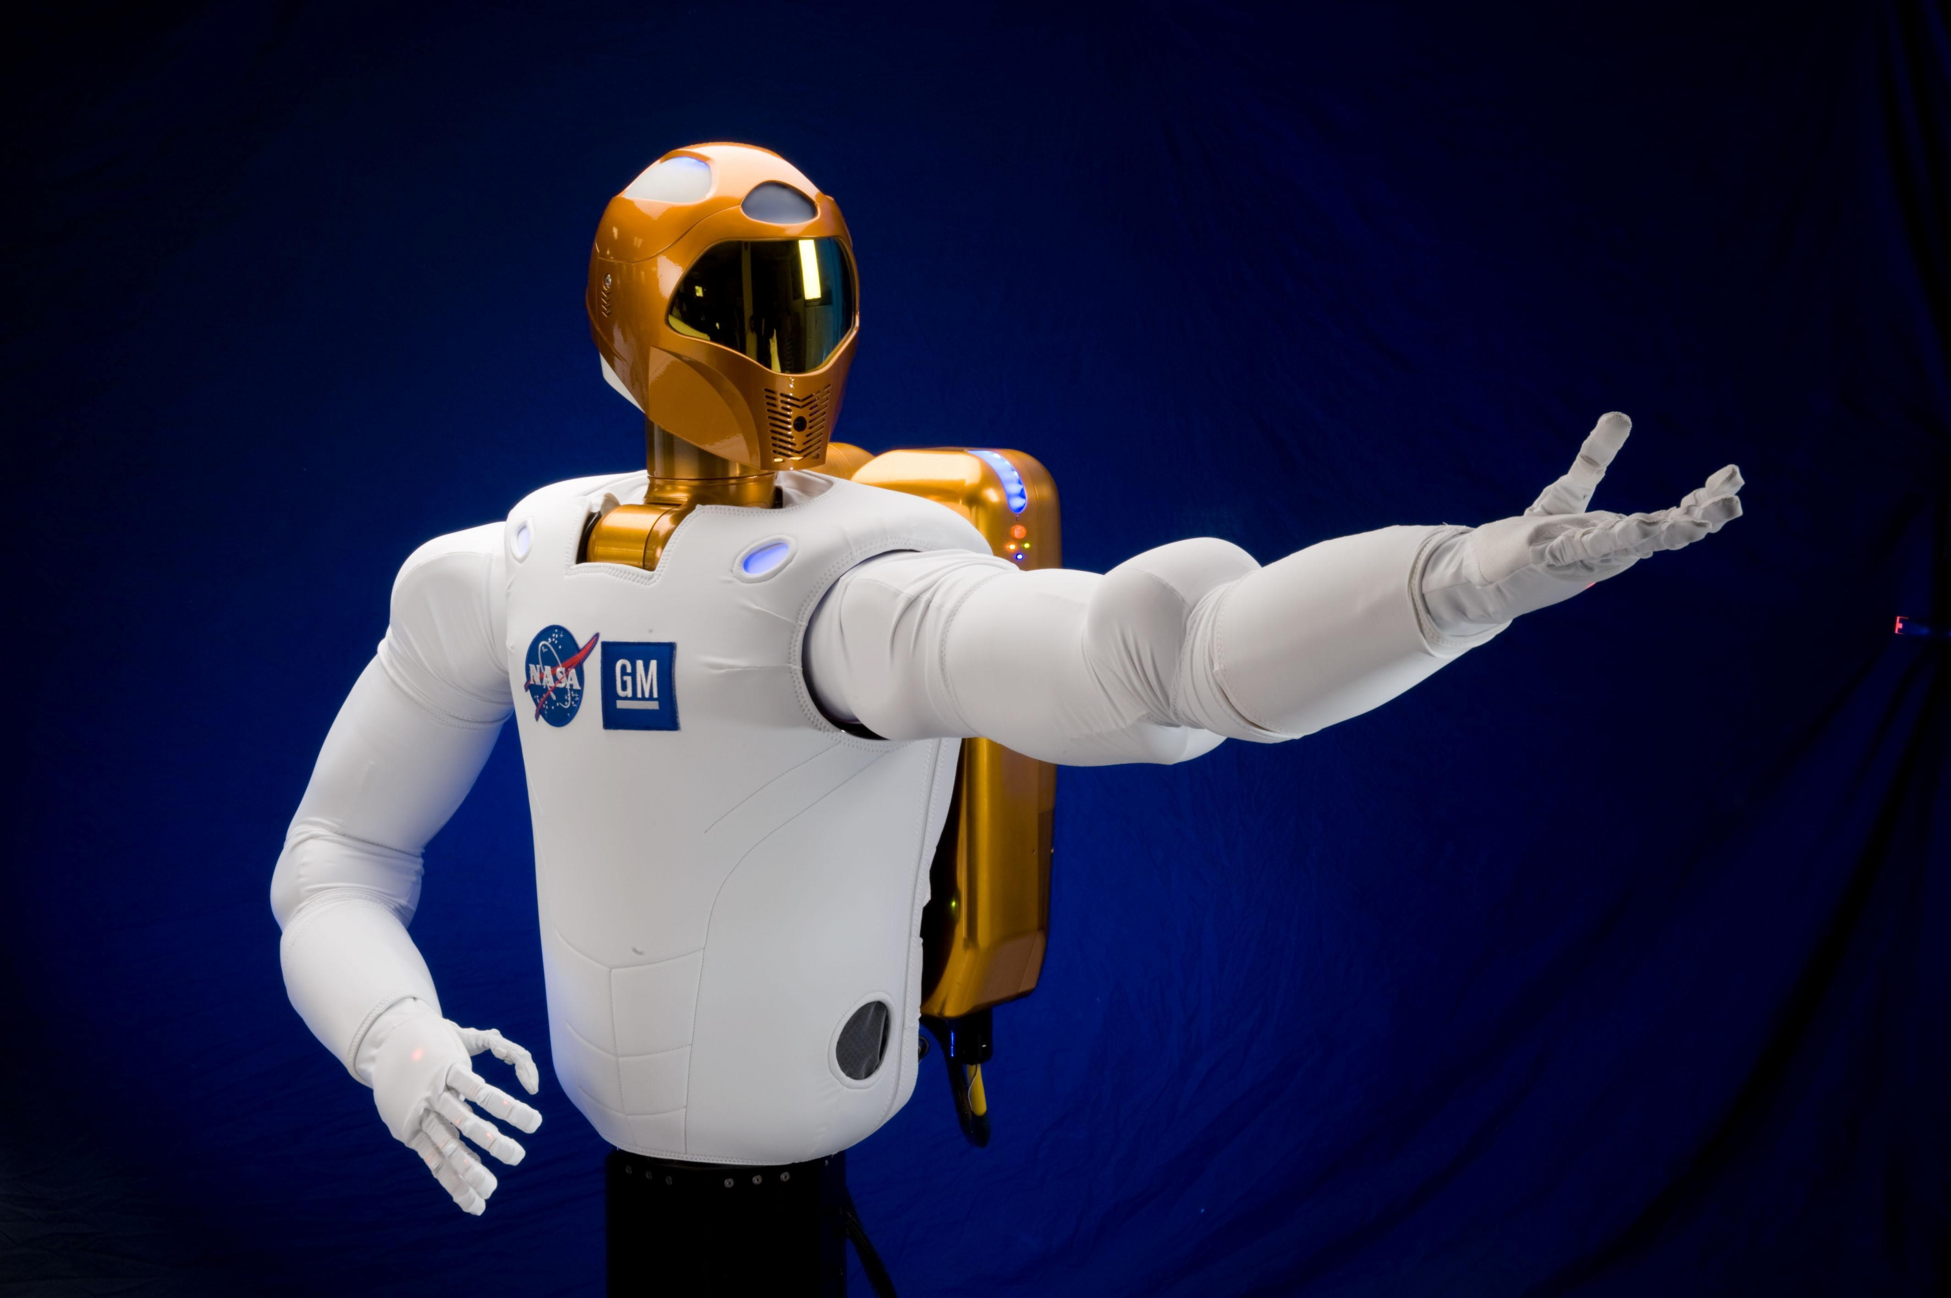
I. Background-Humanoid
Humanoid Robot
Designed to look like and interact like a human
Function in human environments
Robotic arms
Interact with man made environments
Similar motion to human arms
Light weight
Hydraulic and hydraulic hybrid servos
High torque density electromagnetic motors
Atlas
MIT HERMES
Harmonic drive gearboxes
Rollin Justin
ASIMO
ASIMO
Notes:
https://upload.wikimedia.org/wikipedia/commons/8/81/Atlas_frontview_2013.jpg
https://ieeexplore.ieee.org/stamp/stamp.jsp?arnumber=7363420
https://biomimetics.mit.edu/research/mit-hermes-project
Talk more about different actuators
Why not talk about the arm
How is the flow
Give broad info arm of robotic manuipulator
General humanoid robotic manipulator

Slide 4
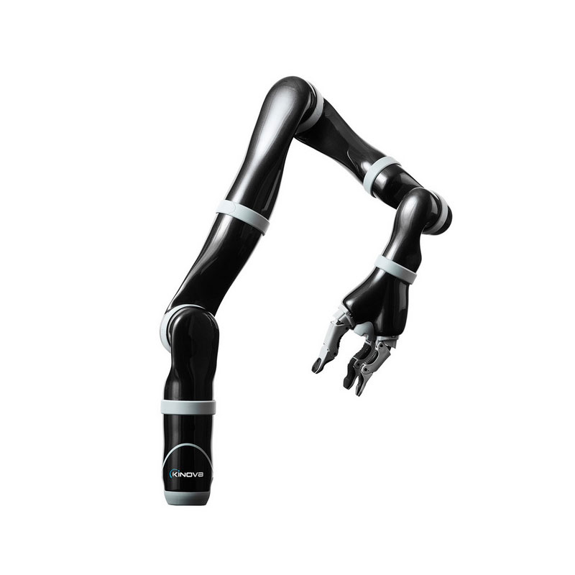
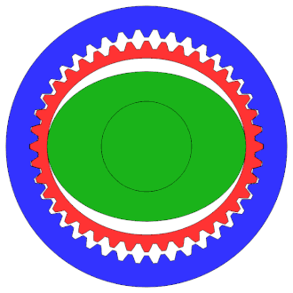
I. Background- Robotic Arm
Robotic Arm
Type of robotic manipulator
Anthropomorphic functionalities
Composed of joints and links
Joints
Revolute Joint (1 DOF)
Joints need to be actuated
Usually an electrical rotational motor with mechanical gears
Harmonic Drive
No backlash
Accuracy
Compact design
Light weight
High gear reduction ratios
Sensors
Encoders
Torque Sensors
Accelerometers and gyroscopes

Slide 5
Table of Contents
Background
Motivation
Design Process
Development
Experimental Testing
Conclusion

Slide 6
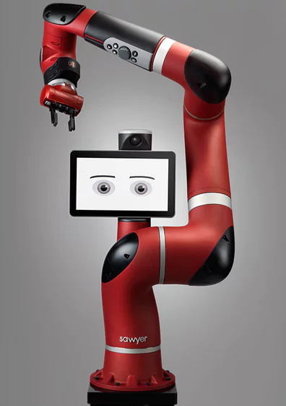
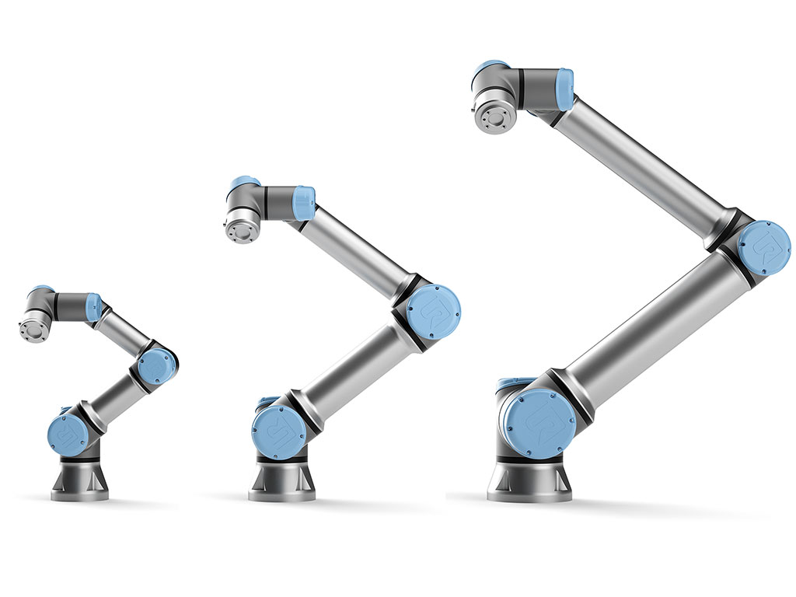
II. Motivation
High performance robotic arms with lightweight, compact size, force/torque sensing, motion feedback, and precise motion controls are very costly.
There is still a strong need for affordable solutions
Easy manufacturability
Rethink Robotics' Baxter Robot (US$22,000 )
KINOVA JACO2 (US$30,000)
UR Arm ($27,000 to $50,000)
Notes:
https://newatlas.com/rethink-robotics-sawyer-robot
https://cobotsguide.com/2016/06/kinova//36680/
This are some common arms used by some shuman oid robots

Slide 7
Table of Contents
Background
Motivation
Design Process
Development
Experimental Testing
Conclusion

Slide 8
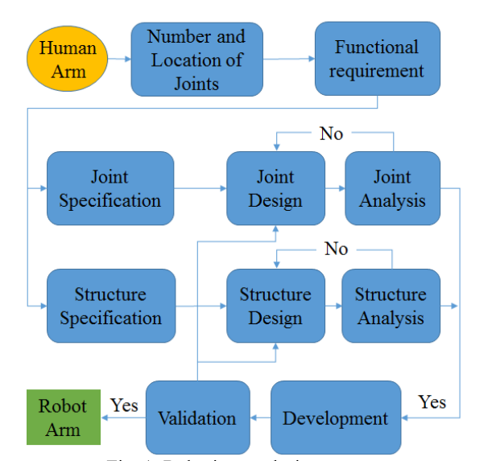
III. Design Process – Flow Diagram
Natural motion
Similar range of motion to a human arm
Joints independently controlled
Light weight and compact design
Manipulation
Should be able to use basic facilities or tools designed for humans
Handle objects up to 2.5 pounds

Slide 9
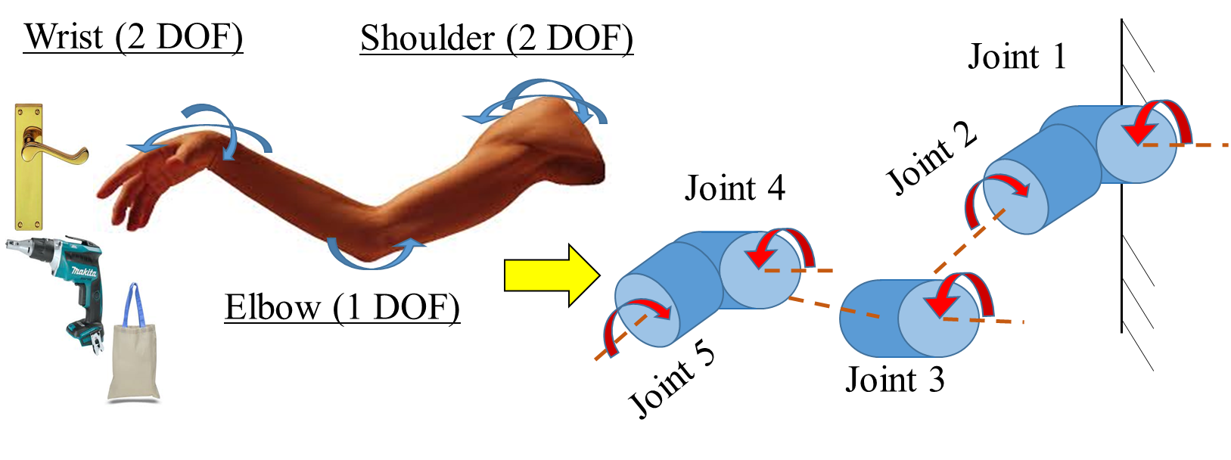
III. Design Process – Configuration
Robotic arm designed to mimic the motion of human arms with similar payload handling capabilities
Robotic arm selected to have similar serial link configuration with 5 joints and link lengths similar to those of human arms

Slide 10
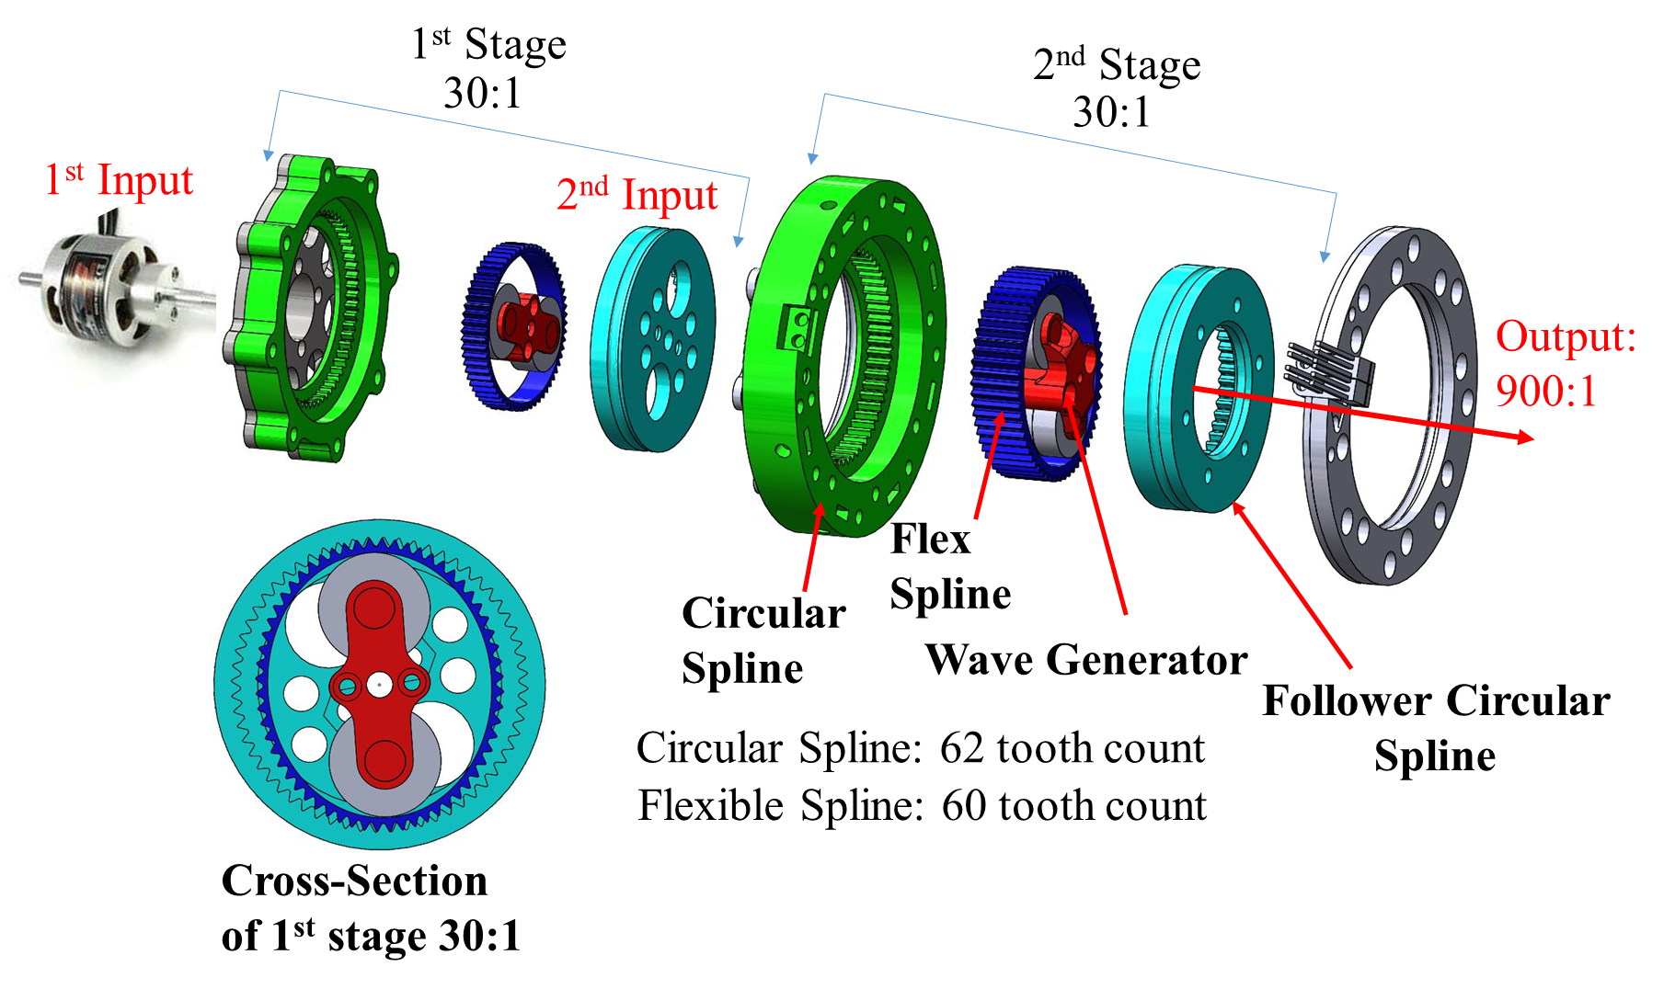
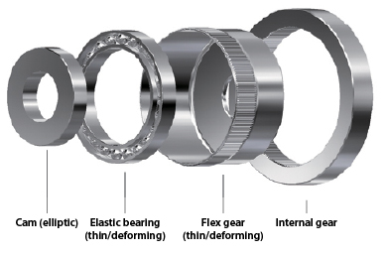
III. Design Process – Joint Design
Each joint composed: Actuator, Harmonic Drive Gearbox, Encoder
Mostly 3D printed parts
Polylactic Acid (PLA) and Nylon
Notes:
Harmonic Drive is not new
Compare to convential harmonic drive
Challenges of printing,
Also heavy
Easy made using printer
Each joint composed:
Actuator
DC motor: Joint 1,2 and 3
Stepper Motor: Joint 4 and 5
Gearbox
Harmonic drive mechanism
high gear reduction ratio
back drivability,
compact assembly
zero-backlash features
Two Stage: Joint 1,2 and 3
Single Stage: Joints 4 and 5
Gear reduction ratio
$$r=\frac{N_{f}}{N_{1}−N_{2}}$$
$N_{f}$= # of teeth on flexible spine, $N_{1}$= fixed circular spine and $N_{2}$= #teeth on follower spline
$N_{f}$=60 $N_{1}$=62 $N_{2}$=60
$$r=900:1$$
Sensing unit

Slide 11
Table of Contents
Background
Motivation
Design Process
Development
Experimental Testing
Conclusion

Slide 12
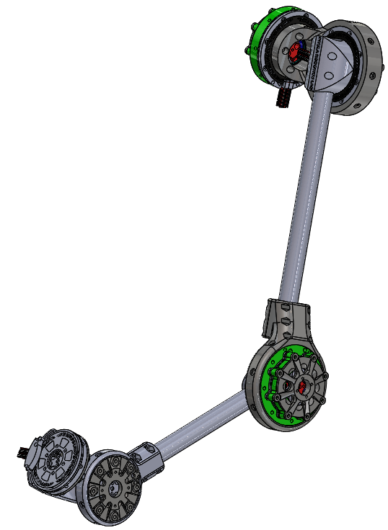
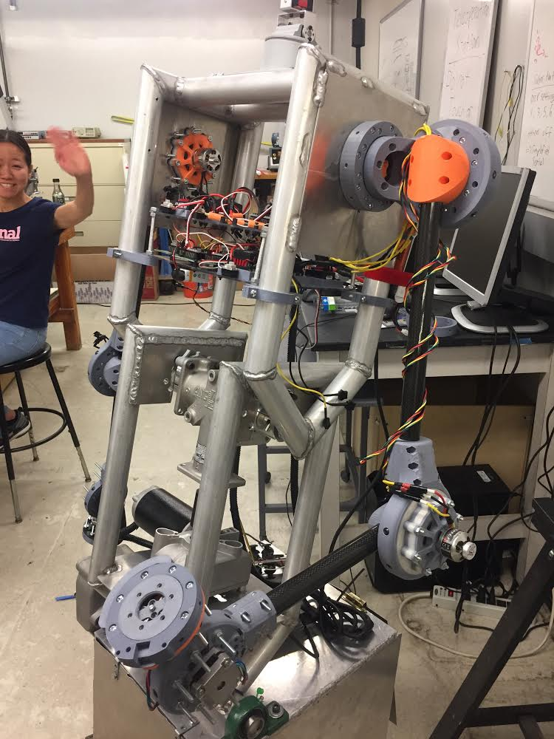
IV. Robot Arm Development - Structure
Carbon fiber composite tubing
Weight of arm = 7 pounds
Length of arm = 31 inches
Electronics Harnessed inside Melo
Shoulder joints and elbow joint are driven by brushless DC motors
Provide 2.5 pound-inches of torque
Wrist joints driven by NEMA 17 stepper motors
Provide 1.12 pound-inches of torque
Shoulder Joints
Elbow Joint
Wrist Joint
Notes:
Cahnge to shoulder and elbow
Change to wrist joints

Slide 13
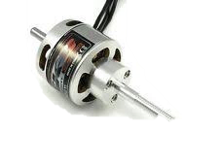
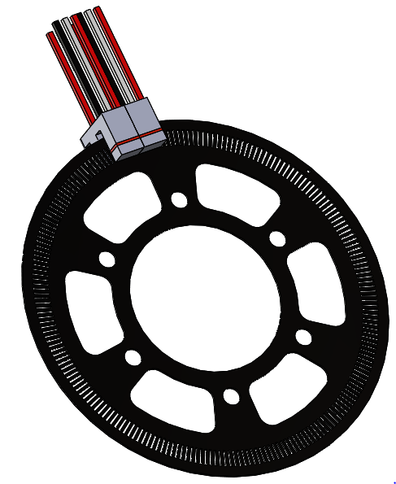
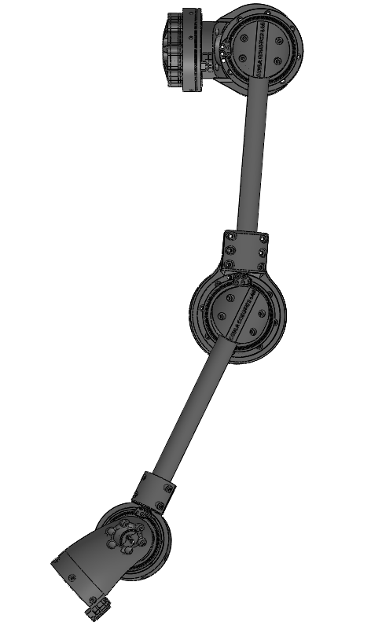
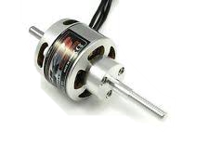

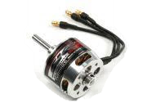
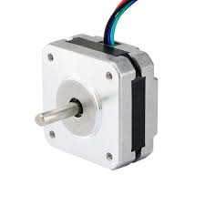
IV. Robot Arm Development - Electronics
Master Slave Control scheme
Motor Drivers
Electronic Speed Controllers
Stepper Drivers
Motors
Brushless DC motors
Stepper Motors
Optical rotary encoder
Two photo interrupters
IR LED receiver and transmitter for index
Motor Drivers
Encoders
Slave
Motors
Left-Arm
Nano
v3.0
ESC
Master
Mega 2560
ESC
Nano
v3.0
ESC
Nano
v3.0
Pololu DRV8825
Pololu DRV8825
Notes:
Master Slave Control scheme
Master: Arduino Mega 2560
Slaves: Arduino Nano
Send Signals to motor drivers
Collects encoder data, to send to master
Powered by 9v Battery
Motor Drivers
Joint 1,2 and 3: Electronics Speed Controllers (ESC)
Joint 4 and 5: Pololu DRV 8825 Stepper driver
Powered by11.1Volt Li-po 5500mAh battery
Optical rotary encoder
Two photo interrupters
OPB960L51 from TT Electronics
IR LED receiver and transmitter for index

Slide 14
Table of Contents
Background
Motivation
Design Process
Development
Experimental Testing
Conclusion

Slide 15
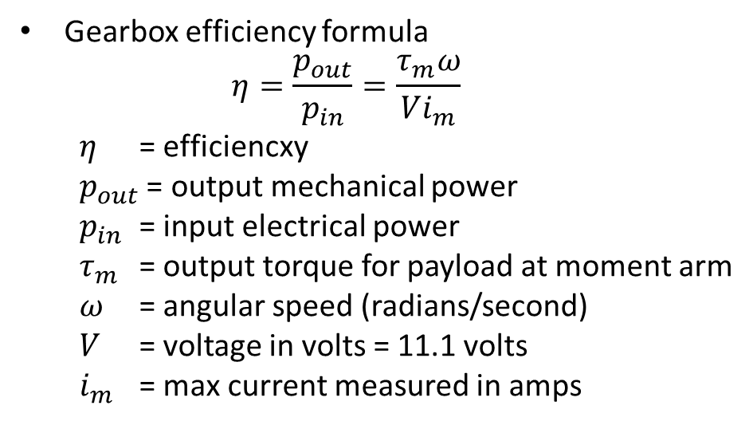
V. Experimental Testing
Maximum Payload Test
Increased payload from 1.5 pounds until 2.75
Gearbox Efficiency Test
Constant payload of 2.75 lbs.
Constant Voltage of 11.1 Volts
Uniform angular speed
Measuring the maximum current
Gearbox efficiency formula
$$η=\frac{p_{out}}{p_{in}}=\frac{τ_{m}ω}{Vi_{m}}$$
$η$ = efficiencxy
$p_{out}$ = output mechanical power
$p_{in}$ = input electrical power
$τ_{m}$ = output torque for payload at moment arm
$ω$ = angular speed (radians/second)
$V$ = voltage in volts = 11.1 volts
$i_{m}$ = max current measured in amps

Slide 16
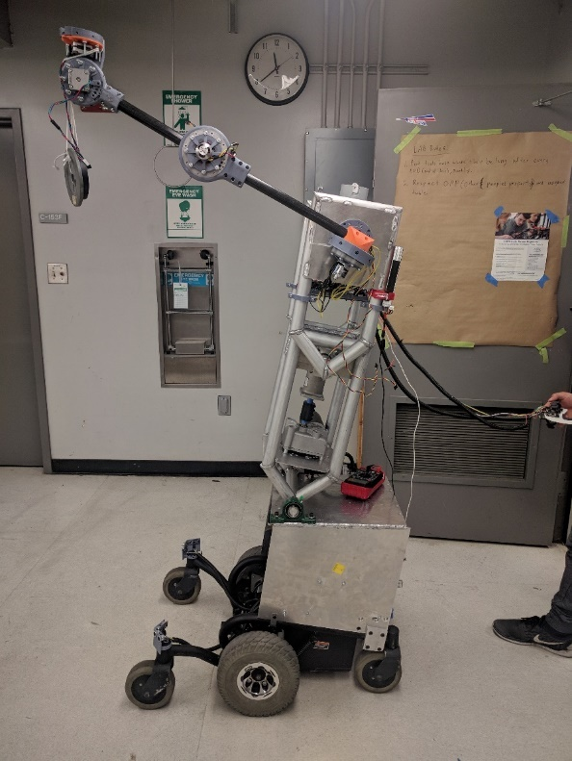
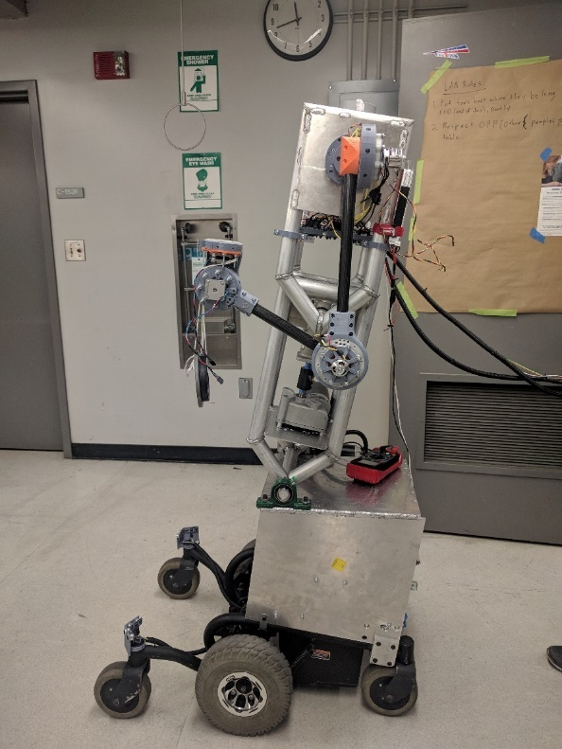
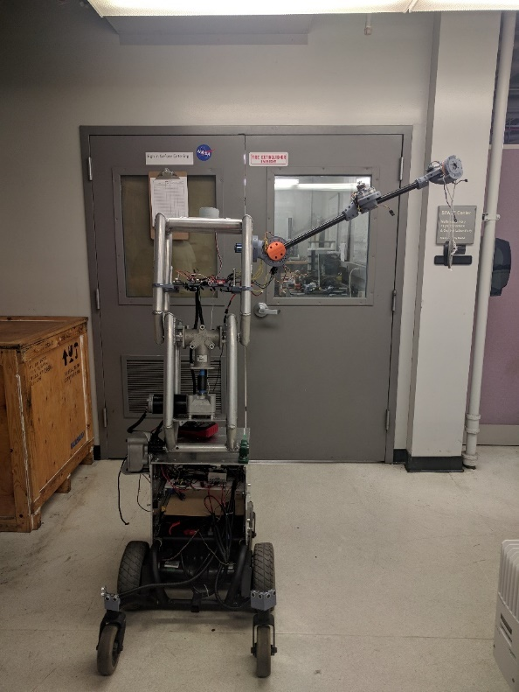
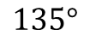
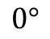
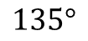
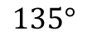
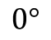
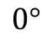
Experimental Testing – Payload
Start with 1.5 pounds at end of arm
Increase by 0.25 pounds until we get to 2.75 pounds
Able to manipulate with desirable speeds
$$135°$$
$$135°$$
$$0°$$
$$0°$$
$$135°$$
$$0°$$

Slide 17
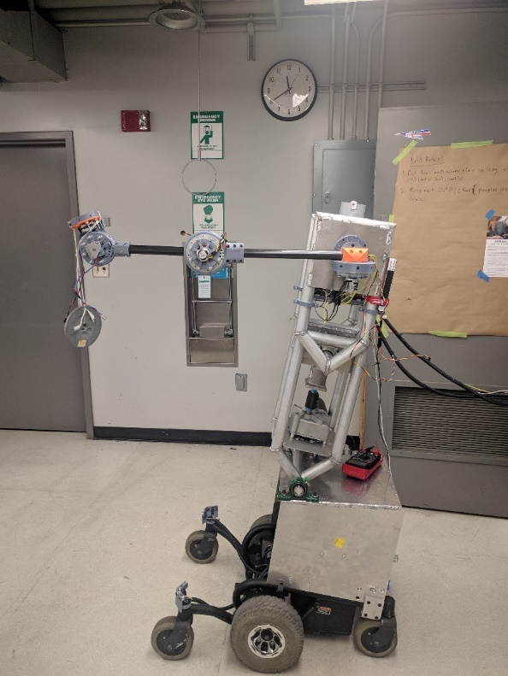

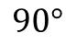
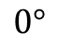
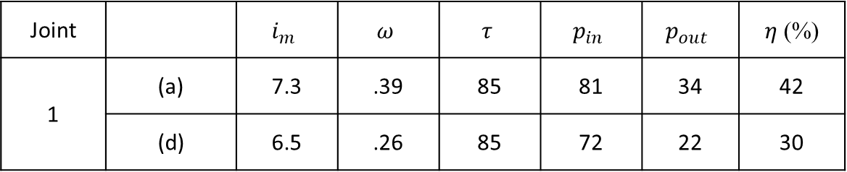
V. Experimental Testing – Efficiency
$$135°$$
$$90°$$
Case 1
$$0°$$
$$0°$$
(a)
(d)
Joint |  | $$i_{m}$$ | $$ω$$ | $$τ$$ | $$p_{in}$$ | $$p_{out}$$ | $η$ (%)
1 | (a) | 7.3 | .39 | 85 | 81 | 34 | 42
 | (d) | 6.5 | .26 | 85 | 72 | 22 | 30
17

Slide 18
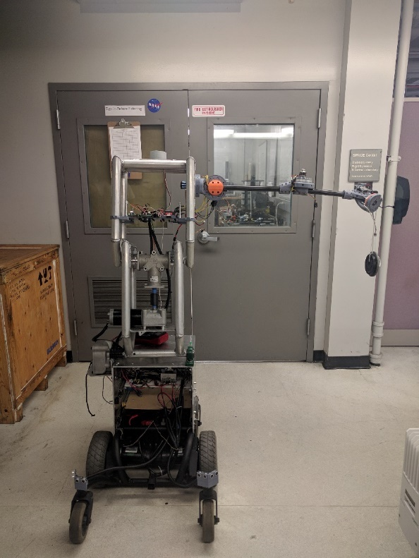
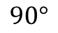
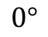
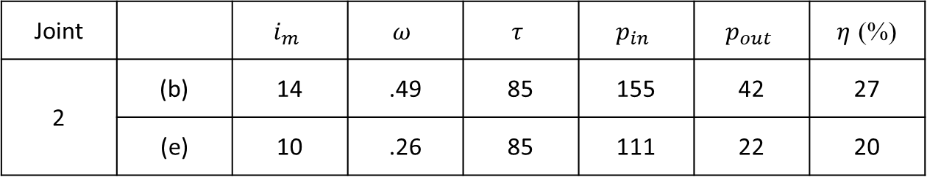
V. Experimental Testing – Efficiency
Case 2
$$135°$$
$$90°$$
$$0°$$
$$0°$$
(b)
(e)
Joint |  | $$i_{m}$$ | $$ω$$ | $$τ$$ | $$p_{in}$$ | $$p_{out}$$ | $η$ (%)
2 | (b) | 14 | .49 | 85 | 155 | 42 | 27
 | (e) | 10 | .26 | 85 | 111 | 22 | 20
Notes:
Increased friction

Slide 19
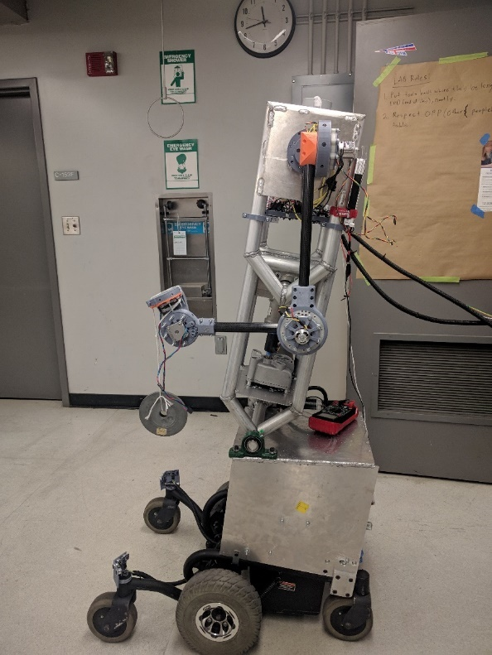
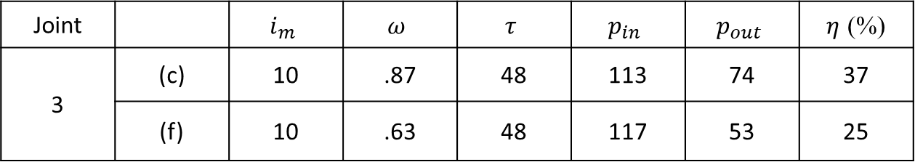
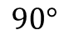
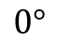
V. Experimental Testing – Efficiency
$$135°$$
$$90°$$
Case 3
$$0°$$
$$0°$$
(c)
(f)
Joint |  | $$i_{m}$$ | $$ω$$ | $$τ$$ | $$p_{in}$$ | $$p_{out}$$ | $η$ (%)
3 | (c) | 10 | .87 | 48 | 113 | 74 | 37
 | (f) | 10 | .63 | 48 | 117 | 53 | 25

Slide 20
VI. Conclusion
Designed and manufactured an affordable light-weight arm
Cost: $695 (USD)
The arm is assembled using mostly 3D printed parts
Demonstrates human like motion and manipulation
Notes:
Add future work

Slide 21
Future Work
Enhancing control system towards autonomous movement
Improving the quality of 3D printing parts through the optimization of 3D printing parameters
Study the effects of heat generation and heat transfer in the joints

Slide 22
Questions?

Slide 23
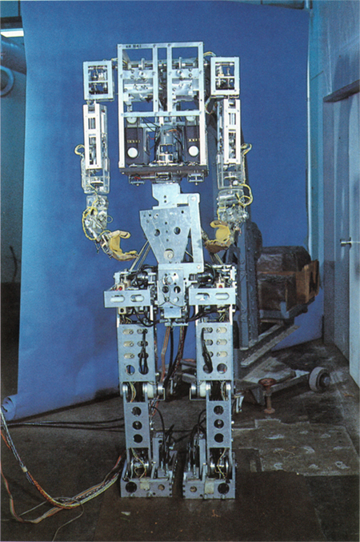
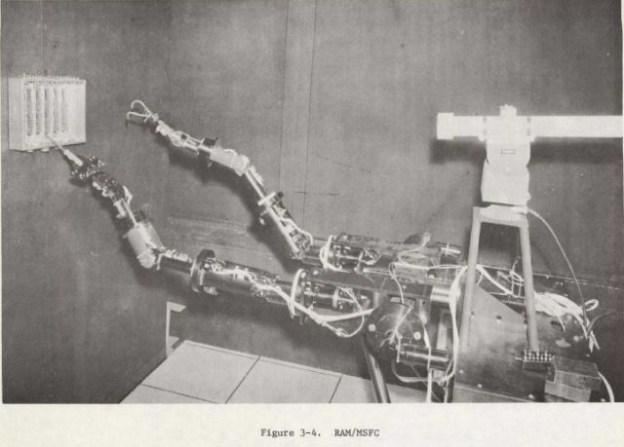
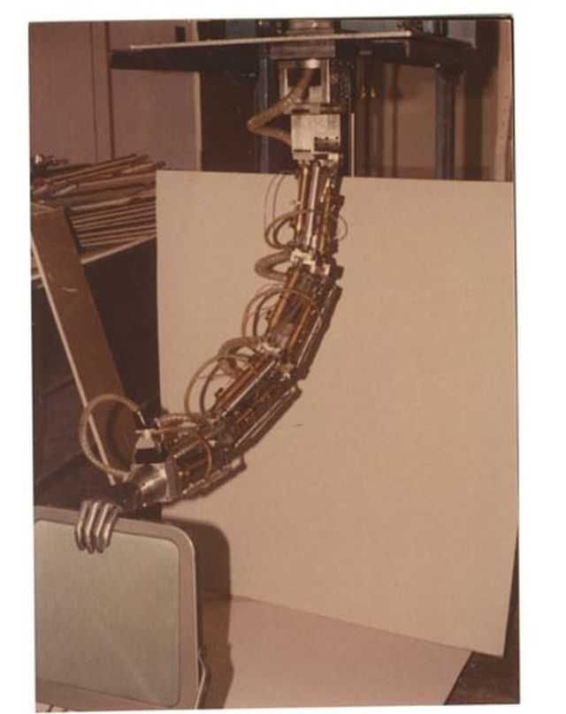
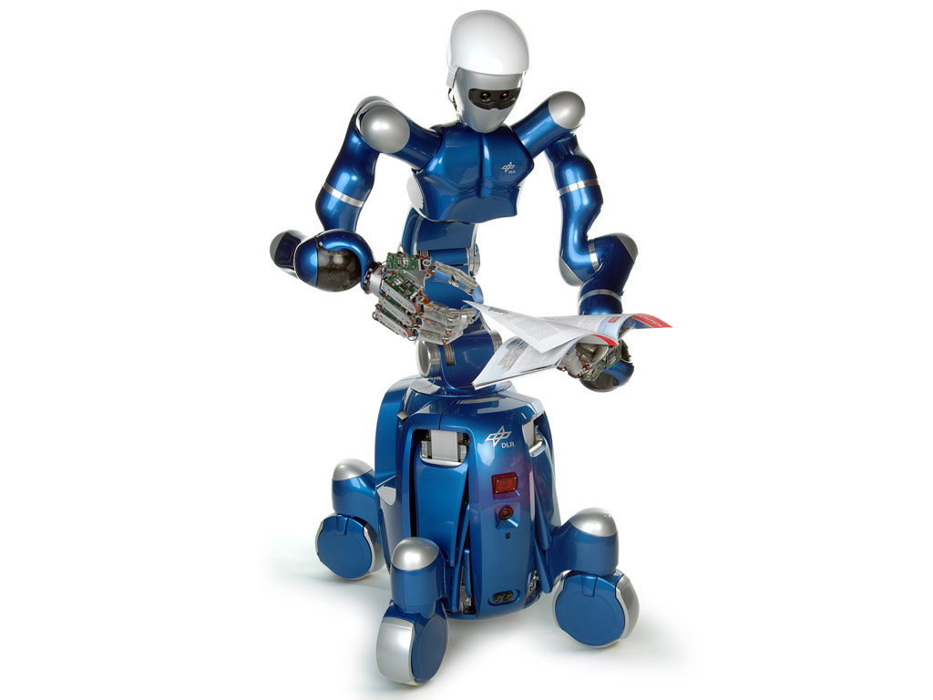
I. Background
Rancho Los Amigos Prosthetic Arm 1963
WABOT-1 1973
Marvin Minsky Arm 1968
Rollin’ Justin 2008
Notes:
http://cyberneticzoo.com/teleoperators/1972-rancho-anthropomorphic-manipulator-ram-rancho-los-amigos-hospital-american/
http://cyberneticzoo.com/underwater-robotics/1968-minsky-bennett-arm-marvin-minsky-and-bill-bennett-american/
http://infolab.stanford.edu/pub/voy/museum/pictures/display/1-Robot.htm
https://www.thocp.net/reference/robotics/robotics2.htm
http://www.humanoid.waseda.ac.jp/booklet/photo/WABOT-1-1973.jpg
Talk in general of what robot arm is
Decrecrease emptyness

Slide 24
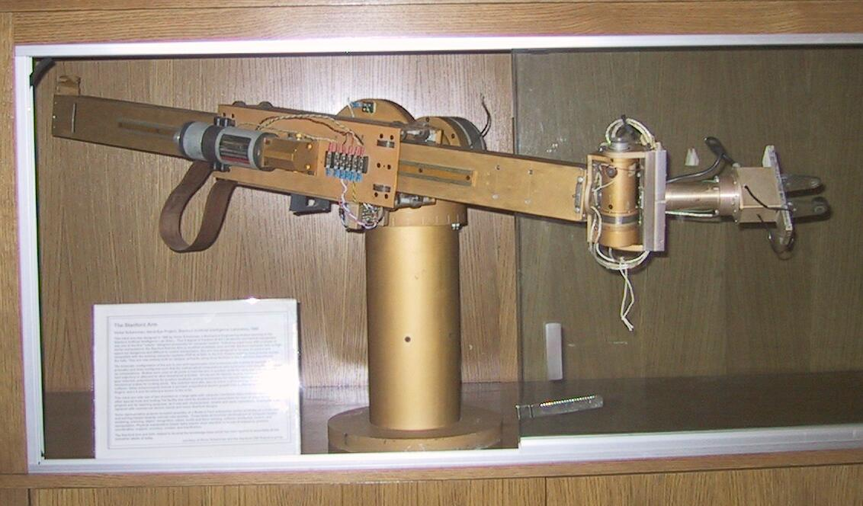
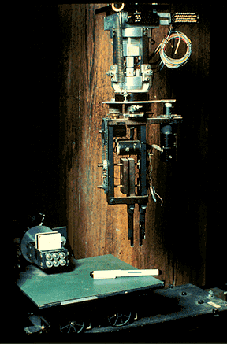
Background
Rancho Los Amigos Manipulator
Stanford Arm 1969
Minsky Arm
Silver Arm 1974
Notes:
http://cyberneticzoo.com/teleoperators/1972-rancho-anthropomorphic-manipulator-ram-rancho-los-amigos-hospital-american/
http://cyberneticzoo.com/underwater-robotics/1968-minsky-bennett-arm-marvin-minsky-and-bill-bennett-american/
http://infolab.stanford.edu/pub/voy/museum/pictures/display/1-Robot.htm
https://www.thocp.net/reference/robotics/robotics2.htm

